Slide 1
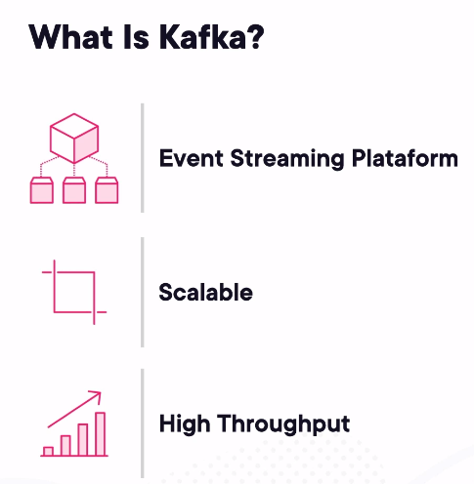
Apache-Kafka
Apache Kafka is a distributed streaming platform. What exactly does that mean?
A streaming platform has three key capabilities:
Publish and subscribe to streams of records, similar to a message queue or enterprise messaging system.
Store streams of records in a fault-tolerant durable way.
Process streams of records as they occur.
Kafka is generally used for building real-time streaming data pipelines that reliably get data between systems or applications
To understand how Kafka does these things, let's dive in and explore first a few concepts:
Kafka is run as a cluster on one or more servers that can span multiple datacenters.
The Kafka cluster stores streams of records in categories called topics.
Each record consists of a key, a value, and a timestamp.

Slide 2
Difference between Kafka and rest of systems
Rabbit MQ : As Kafka uses topics in a unidirectional log without handshake, the performance improvement is almost 1000x.
MuleSoft: Kafka makes it simple to create a channel or topic automatically when a message is produced.
Redis: Unlike Kafka, Redis neither handles streaming data nor maintains history of past messages
Amazon SQS: It is costlier compared to Kafka and there is an order of magnitude in throughput.
Amazon SNS: This is very similar to Kafka but too costly compared to Kafka.

Slide 3
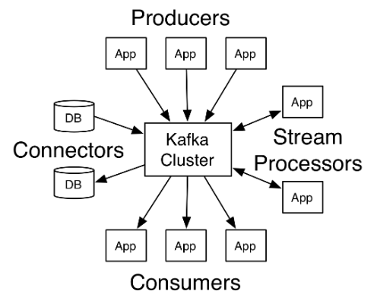
Kafka has four core APIs
The Producer API allows an application to publish a stream of records to one or more Kafka topics.
The Consumer API allows an application to subscribe to one or more topics and process the stream of records produced to them.
The Streams API allows an application to act as a stream processor, consuming an input stream from one or more topics and producing an output stream to one or more output topics, effectively transforming the input streams to output streams.
The Connector API allows building and running reusable producers or consumers that connect Kafka topics to existing applications or data systems. For example, a connector to a relational database might capture every change to a table.

Slide 4
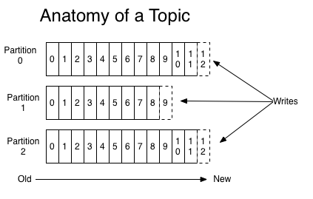
Topics and Logs
A topic is a category or feed name to which records are published. Topics in Kafka are always multi-subscriber; that is, a topic can have zero, one, or many consumers that subscribe to the data written to it.
For each topic, the Kafka cluster maintains a partitioned log.
Each partition of a topic is an ordered, immutable sequence of records that is continually appended to a structured commit log.
The records in the partitions are each assigned a sequential id number called the offset that uniquely identifies each record within the partition.

Slide 5
Replication
The partitions of the log are distributed over the servers in the Kafka cluster with each server handling data and requests for a share of the partitions.
Each partition is replicated across a configurable number of servers for fault tolerance.
Each partition has one server which acts as the "leader" and zero or more servers which act as "followers".
The leader handles all read and write requests for the partition while the followers passively replicate the leader.
If the leader fails, one of the followers will automatically become the new leader.
Each server acts as a leader for some of its partitions and a follower for others so load is well balanced within the cluster.

Slide 6
Producers & consumers
Producers
Producers publish data to the topics of their choice.
The producer is responsible for choosing which record to assign to which partition within the topic. This can be done in a round-robin fashion simply to balance load or it can be done according to some semantic partition function (say based on some key in the record).
Consumers
Consumers reads the data from the topic they subscribe to.

Slide 7
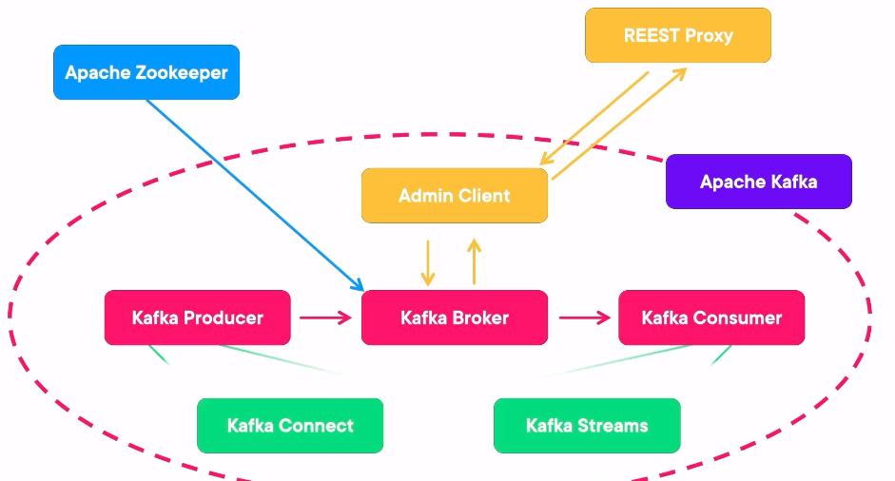
Kafka Architecture

Slide 8
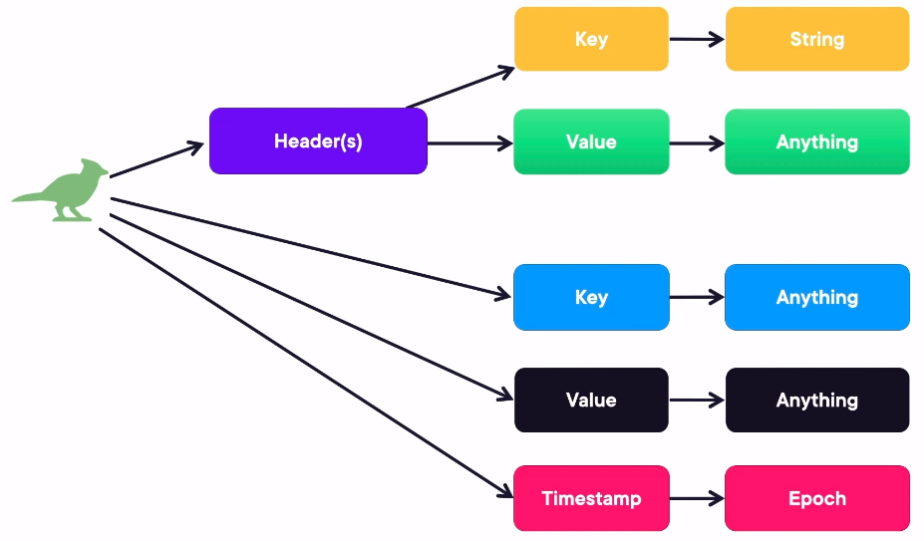
Kafka Architecture

Slide 9
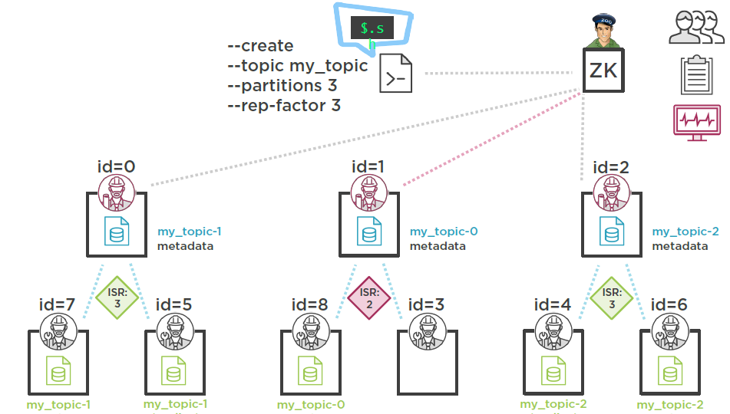
Kafka Architecture

Slide 10
Start single broker on a single node
Start Zookeeper
zookeeper-server-start.sh $KAFKA_HOME/config/zookeeper.properties
(It will start zookeeper service with port 2181, and manage kafka brokers, If port 2181 is already in use change the port in zookeeper.properties)
To verify type telnet localhost 2181 and then type <stat> to check the zookeeper status.
Start a broker by using following command that will be registered with zookeeper
kafka-server-start.sh $KAFKA_HOME/config/server.properties
List available topic
kafka-topics.sh --zookeeper localhost:5181 -list
Create a new topic
kafka-topics.sh --create --zookeeper localhost:5181 --partitions 1 --replication-factor 1 --topic mytopic
It will create a directory /tmp/kafka-logs,
In this, it will maintain the indexes and messages in binary format

Slide 11
Start single broker on a single node
Describe the topic
kafka-topics.sh --describe --topic mytopic --zookeeper localhost:5181
To delete a topic
kafka-topics.sh --delete --zookeeper localhost:5181 --topic mytopic
Create Consumer
kafka-console-consumer.sh --zookeeper localhost:5181 --topic mytopic --from-beginning
kafka-console-consumer.sh --bootstrap-server localhost:9092 --topic mytopic --from-beginning
Kafka new version instead of --zookeeper it should be --bootstrap -server
Create Producer
kafka-console-producer.sh --broker-list localhost:9092 --topic mytopic
To Check Kafka broker name
cat $KAFKA_HOME/config/consumer.properties
cat /etc/kafka/conf/kafka-client.conf (If CDH cluster)

Slide 12
Multiple broker on a single node
To start multiple broker, create 3 copy of server.properties file in $KAFKA_HOME/config
cp $KAFKA_HOME/config/server.properties $KAFKA_HOME/config/server1.properties
cp $KAFKA_HOME/config/server.properties $KAFKA_HOME/config/server2.properties
cp $KAFKA_HOME/config/server.properties $KAFKA_HOME/config/server3.properties
Modify the below in each server.properties file
sudo gedit $KAFKA_HOME/config/server1.properties
broker.id=1
port=9093 //Add as a new line
zookeeper.connect=localhost:5181
log.dir=/tmp/kafka-logs-1
sudo gedit $KAFKA_HOME/config/server2.properties
broker.id=2
port=9094 //Add as a new line
zookeeper.connect=localhost:5181
log.dir=/tmp/kafka-logs-2

Slide 13
Multiple broker on single node contd.
sudo gedit $KAFKA_HOME/config/server3.properties
broker.id=3
port=9095 //Add as a new line
zookeeper.connect=localhost:5181
log.dir=/tmp/kafka-logs-3
Start 3 brokers
kafka-server-start.sh $KAFKA_HOME/config/server1.properties
kafka-server-start.sh $KAFKA_HOME/config/server2.properties
kafka-server-start.sh $KAFKA_HOME/config/server3.properties
Create a new topic with replication factor 3
kafka-topics.sh --create --zookeeper localhost:5181 --partitions 1 --replication-factor 3 --topic mytopic_Krishna
It will create three log directories
/tmp/kafka-logs-1
/tmp/kafka-logs-2
/tmp/kafka-logs-3

Slide 14
Start multi broker on a single node
Start a producer
kafka-console-producer.sh --broker-list localhost:9093,localhost:9094,localhost:9095 --topic mytopic_Krishna
Start a consumer
kafka-console-consumer.sh --zookeeper localhost:5181 --topic mytopic_Krishna --from-beginning
Describe the topic and observer below important points
kafka-topics.sh --describe --topic mytopic2 --zookeeper localhost:5181
Verify the leader is brokerID 1
Which means producer will write messages to this broker and other will replicate it.
Replicas are in all brokers (ID-1,2,3)
InsyncReplicas are in 1 first then 2 followed by 3.

Slide 15
Check Fault tolerance - Multiple Broker
Now Kill the instance and verify the leader now
kill the leader broker instance (broker ID 1 ), describe broker,
Notice automatically leader have changed and once the broker is back InsyncReplicas (ISR) also is maintained.
Describe the topic and observer below important points
kafka-topics.sh --describe --topic mytopic2 --zookeeper localhost:5181
Verify the new leader is now brokerID 2
Which means producer will write messages to this broker now and other will replicate it.
Replicas are in all brokers (ID-1,2,3)
But InsyncReplicas are in 2 first then followed by 3.
Now run the broker ID 1 again see the ISR order is changed.

Slide 16
Kafka on CDH cluster
To Check Kafka broker name
cat /etc/kafka/conf/kafka-client.conf (If CDH cluster)
List available topic
kafka-topics --zookeeper e2e-27-143.e2enetworks.net.in:2181 -list
Create a new topic
kafka-topics --create --zookeeper e2e-27-143.e2enetworks.net.in:2181 --replication-factor 1 --partitions 1 --topic mytopic_san1
Describe the topic
kafka-topics --describe --topic mytopic_san1 --zookeeper e2e-27-143.e2enetworks.net.in:2181

Slide 17
Kafka on CDH cluster
To delete a topic
kafka-topics --delete --zookeeper e2e-27-143.e2enetworks.net.in:2181 --topic mytopic_san1
Create Consumer
kafka-console-consumer --zookeeper e2e-27-144.e2enetworks.net.in:2181 --topic mytopic_san1
Create Producer
kafka-console-producer --broker-list e2e-27-153.e2enetworks.net.in:9092 --topic mytopic_san1

Slide 18
Why FLAFKA?
KAFKA
One key feature of Kafka is its functional simplicity. While there is a lot of sophisticated engineering under the covers, Kafka’s general functionality is relatively straightforward. Part of this simplicity comes from its independence from any other applications (excepting Apache ZooKeeper).
However, the responsibility is on the developer to write code to either produce or consume messages from Kafka. While there are a number of Kafka clients that support this process, for the most part custom coding is required.
Flume
Flume is a distributed, reliable, and available system for efficiently collecting, aggregating, and moving large amounts of data from many different sources to a centralized data store. Flume provides a tested, production-hardened framework for implementing ingest and real-time processing pipelines.
Flume can both read and write messages with Kafka.
Flume-Kafka integration offers the following functionality that Kafka, absent custom coding, does not.
Producers – Use Flume sources to write to Kafka
Consumers – Write to Flume sinks reading from Kafka
A combination of the above

Slide 19
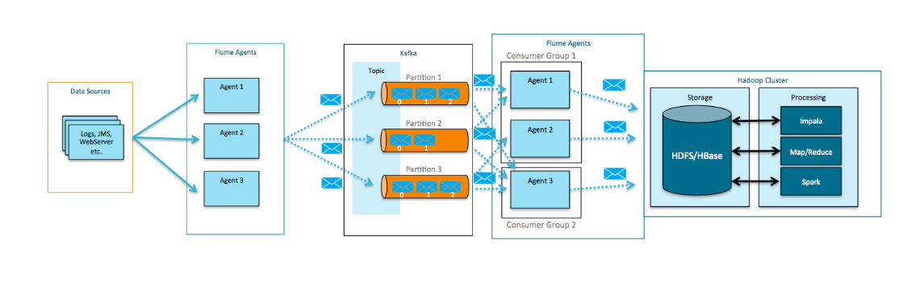
FLAFKA Architecture

Slide 20
flafka_producer
FlafkaAgent.sources = Netcat
FlafkaAgent.channels = MemChannel
FlafkaAgent.sinks = kafka-sink-1
FlafkaAgent.sources.Netcat.type = netcat
FlafkaAgent.sources.Netcat.bind = localhost
FlafkaAgent.sources.Netcat.port = 56565
FlafkaAgent.channels.MemChannel.type = memory
FlafkaAgent.channels.MemChannel.capacity = 100
FlafkaAgent.channels.MemChannel.transactionCapacity = 100
FlafkaAgent.sources.Netcat.channels = MemChannel
FlafkaAgent.sinks.kafka-sink-1.type = org.apache.flume.sink.kafka.KafkaSink
FlafkaAgent.sinks.kafka-sink-1.topic = flafkatopic
FlafkaAgent.sinks.kafka-sink-1.brokerList = broker-list localhost:9092
FlafkaAgent.sinks.kafka-sink-1.requiredAcks = 1
FlafkaAgent.sinks.kafka-sink-1.batchSize = 20
FlafkaAgent.sinks.kafka-sink-1.channel = MemChannel

Slide 21
flafka_consumer
flume1.sources = kafka-source-1
flume1.channels = hdfs-channel-1
flume1.sinks = hdfs-sink-1
flume1.sources.kafka-source-1.type = org.apache.flume.source.kafka.KafkaSource
flume1.sources.kafka-source-1.zookeeperConnect = localhost:5181
flume1.sources.kafka-source-1.topic = flafkatopic
flume1.sources.kafka-source-1.batchSize = 100
flume1.sources.kafka-source-1.channels = hdfs-channel-1
flume1.channels.hdfs-channel-1.type = memory
flume1.sinks.hdfs-sink-1.channel = hdfs-channel-1
flume1.sinks.hdfs-sink-1.type = hdfs
flume1.sinks.hdfs-sink-1.hdfs.writeFormat = Text
flume1.sinks.hdfs-sink-1.hdfs.fileType = DataStream
flume1.sinks.hdfs-sink-1.hdfs.filePrefix = test-events
flume1.sinks.hdfs-sink-1.hdfs.useLocalTimeStamp = true
flume1.sinks.hdfs-sink-1.hdfs.path = /tmp/kafka/%{topic}/%y-%m-%d
flume1.sinks.hdfs-sink-1.hdfs.rollCount=100
flume1.sinks.hdfs-sink-1.hdfs.rollSize=0
flume1.channels.hdfs-channel-1.capacity = 10000
flume1.channels.hdfs-channel-1.transactionCapacity = 1000

Slide 22
Example FLAFKA
Create a topic in KAFKA
kafka-topics.sh --create --zookeeper localhost:5181 --partitions 1 --replication-factor 1 --topic flafkatopic
Run Flume agent to read data from netcat which will be a producer to Kafka topics
flume-ng agent --name FlafkaAgent --conf $FLUME_HOME/conf/ --conf-file code/flumeprop/flafka_producer -Dflume.root.logger=INFO,console
Run another Flume agent to read data from Kafka topics and write to HDFS
flume-ng agent --name flume1 --conf $FLUME_HOME/conf/ --conf-file code/flumeprop/flafka_consumer -Dflume.root.logger=INFO,console
Verify the data in HDFS
hadoop fs -ls /tmp/kafka

